Slide 1
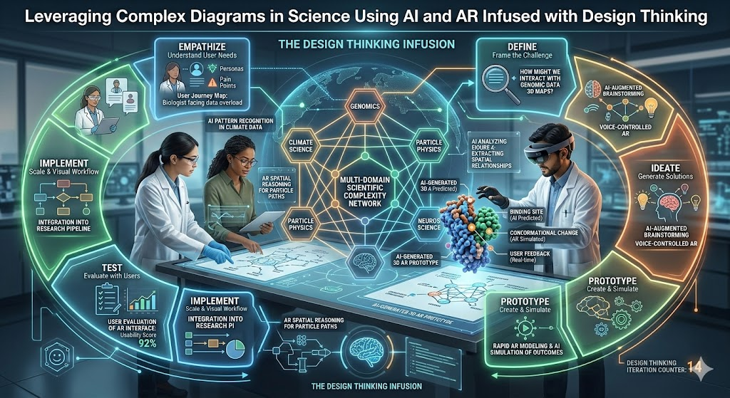
DT BASED CAPSTONE PROJECT-
Academic Problem-
Leveraging Complex Diagrams in Science Using AI and AR Infused with Design Thinking
Target Group- Std X

Slide 2
SCOPE
Phase 1
Stage I – Brainstorming (Tool)
Activity: Group discussion and brainstorming
Key Questions-
Which science diagrams are most difficult for students to understand?
Why do students struggle with textbook diagrams?
Can technology help visualize scientific processes better?

Slide 3
Brainstorming Focus-
Identify complex diagrams in Science that students struggle to interpret (e.g., human heart, electric circuits, cell structure).
Explore how AI explanations and AR visualization can make these diagrams interactive and easier to understand.
Discuss learning challenges, opportunities, and innovative ideas to enhance conceptual clarity.
Tools Used-
Group discussion / brainstorming sessions among students and teachers.
Stakeholders (students and teachers)

Slide 4
Stage II – Idea Posting-
Identify diagrams in science that students commonly find difficult (e.g., human heart, electric circuits, cell structure).

Slide 5
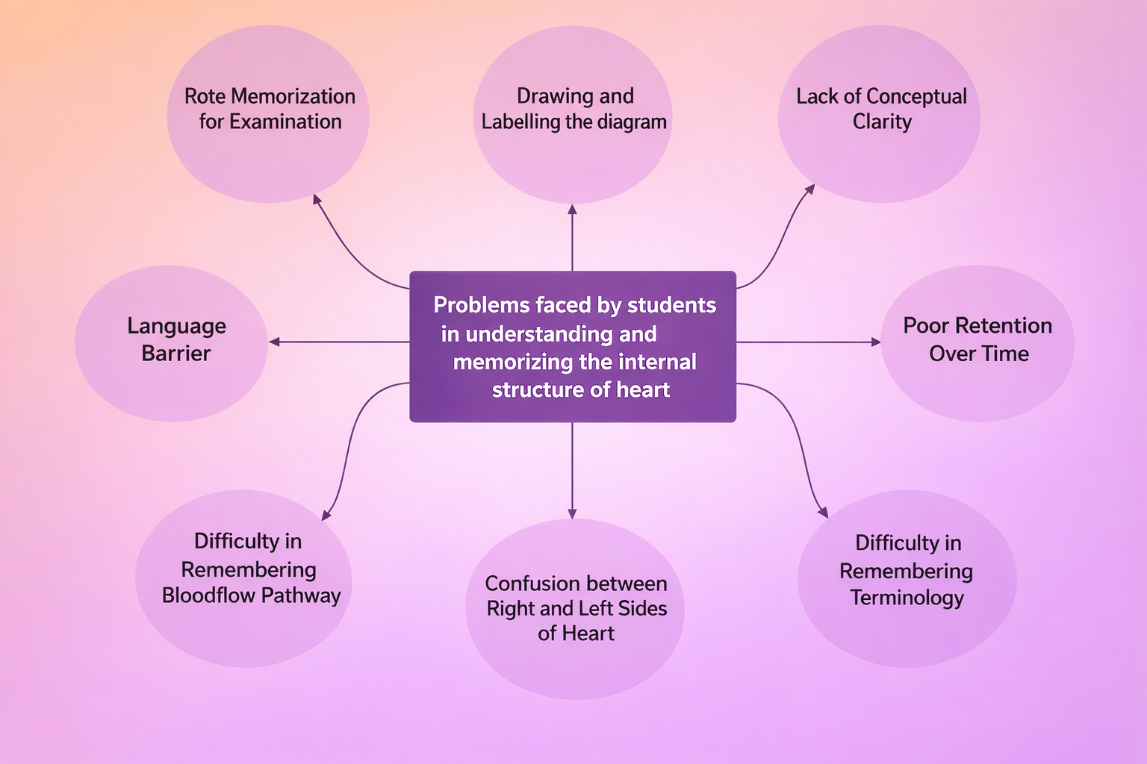

Slide 6
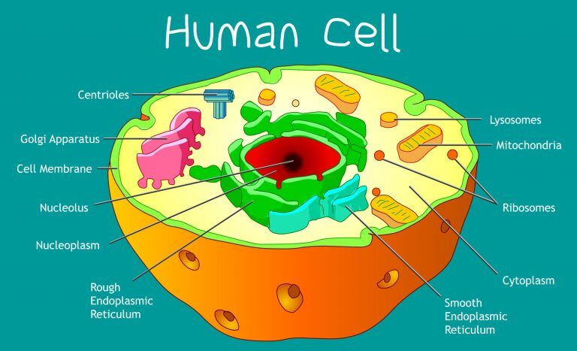

Slide 7
Empathize-
Phase 2
Stage III –
Survey form (Questionnaire for Students and Teachers)-
Ms Form for Students-
Students form
Ms Form for Teachers-
Teachers form

Slide 8
Define-
Phase 3
Stage IV –
Define the problem:
How can we make complex diagrams easier to understand?
Do students find complex science diagrams difficult to understand from textbooks alone?
Do static 2D diagrams make it hard to visualize how scientific processes actually work?
Do students struggle to connect labels in diagrams with their functions or processes?

Slide 9
Phase | Stage | Activity | Application in the Capstone Project
Ideate | Stage V | Reflection (Mapping with requirements) | Students analyse the challenges faced while understanding complex diagrams such as the human heart, electric circuits, and cell structure. They reflect on how AI tools can simplify explanations and how AR can help visualize diagrams in 3D. Requirements like digital devices, internet access, and suitable AI/AR tools are identified.

Slide 10
Ideate | Stage VI | Design of Modules (Phased manner – Work force identification) | Students divide the project into modules: Module 1 – Identification of complex diagrams, Module 2 – AI-based explanation and labeling, Module 3 – AR visualization of diagrams, Module 4 – Interactive learning and quiz creation. Teams are formed such as Research Team, Technology Team, Design Team, and Presentation Team.

Slide 11
Ideate | Stage VII | Resource Identification | Students identify required resources such as AI tools for diagram explanation, AR applications for 3D visualization, digital devices (tablets/smartphones), internet connectivity, science textbooks, and teacher guidance.

Slide 12
Ideate | Stage VIII | Planning | Students prepare a step-by-step implementation plan: select difficult diagrams → generate AI explanations → create AR-based models → design interactive activities → present the prototype. Timeline and responsibilities for each team are finalized.

Slide 13
Ideate | Stage IX | Re-Design | Based on feedback from peers and teachers, students improve the model by simplifying explanations, enhancing AR visualization, improving labeling, and adding interactive quizzes or animations to make learning more engaging.

Slide 14
SCAMPER technique was used during the Ideate phase (Stage V, VI and IX) to generate innovative ideas for transforming traditional science diagrams into interactive AI- and AR-supported learning tools.

Slide 15
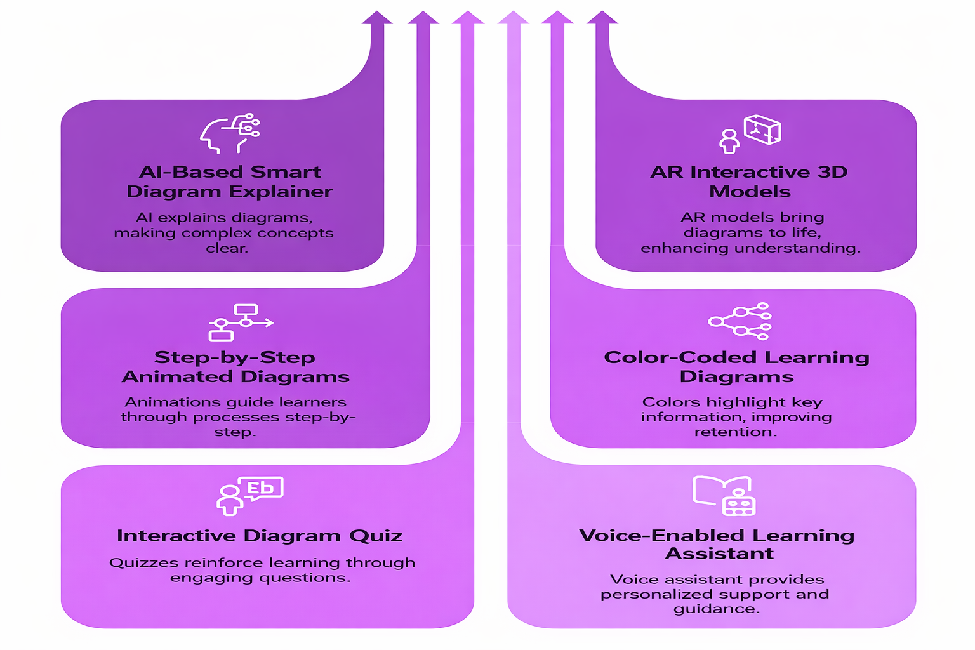

Slide 16
Prototype | Stage X | Execution Framework (Modules) | Students develop the project through structured modules: Module 1 – Identification of complex diagrams (heart, cell structure, electric circuits), Module 2 – AI-assisted explanation and labeling, Module 3 – AR-based 3D visualization of diagrams, Module 4 – Interactive learning activities such as quizzes and animations.

Slide 17
Prototype | Stage XI | Micromodules (Focus) | Each module is divided into smaller tasks: selecting diagrams, generating AI explanations, creating AR visualization, testing interactive elements, and preparing simplified explanations for peer learning.

Slide 18
Prototype | Stage XII | Execution Process Flow | Step-by-step workflow: Identify difficult diagrams → Use AI tools to simplify explanations → Convert diagrams into AR models → Create interactive learning content → Demonstrate the working prototype to peers and teachers.

Slide 19
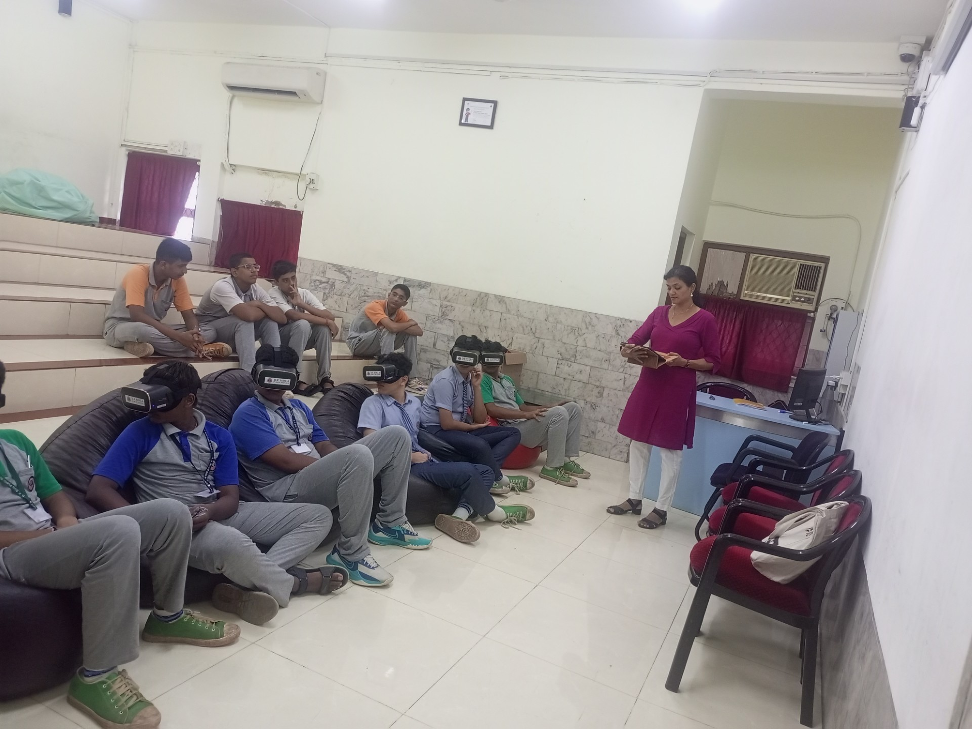

Prototype-
Phase 5
Create interactive diagrams, 3D models, or AR overlays using digital tools.
AI app – Hologram in Ipads
AR tool VR glasses
3D - Classes

Slide 20
Test –
Phase 6
Present the model to peers and gather feedback through microsoft forms (post assessment), mentimeter poll on clarity and usability.

Slide 21
Validation | Stage XIII | Testing (Mapping the requirements) | The prototype is tested by students and teachers to check whether AI explanations are clear, AR models improve visualization, and students understand diagrams better. Feedback is collected to measure improvement in conceptual clarity. post assessment

Slide 22
Implementation | Stage XIV | Implement (Deployment) | The AI–AR diagram learning model is introduced in classroom learning where students use the tool to explore complex diagrams interactively. Teachers integrate it during science lessons for improved engagement and understanding.

Slide 23
Report | Stage XV | Retrospective | Students reflect on the project outcomes, challenges faced, improvements made, and the impact of AI and AR on learning science diagrams. Final documentation includes process steps, prototype demonstration, feedback analysis, and future improvements.

Slide 24
Thank You

